Slide 1





Astor AI -
Chatbot for Medical Queries
By A. Phani Charan (Group G33)

Slide 2
Problem Statement
In many situations, accessing immediate medical advice can be challenging, particularly for non-critical conditions. There is a significant potential for AI to bridge this gap by providing reliable and timely responses to patient queries, enhancing the accessibility of healthcare information.
Develop a robust AI-powered chatbot capable of understanding and responding to medical queries.
Ensure the chatbot provides relevant and accurate answers, improving the quality of initial diagnosis and guidance.
Implement features that mimic doctor appointments, allowing users to have detailed and contextually relevant interactions.

Slide 3
Tech Stack
AI and ML :- Llama 3 Model, Huggingface, Ollama, Google Colab
Database :- MongoDB
Frontend :- ReactJS
Backend :- Python, Flask
Authorization and Authentication :- JWT

Slide 4
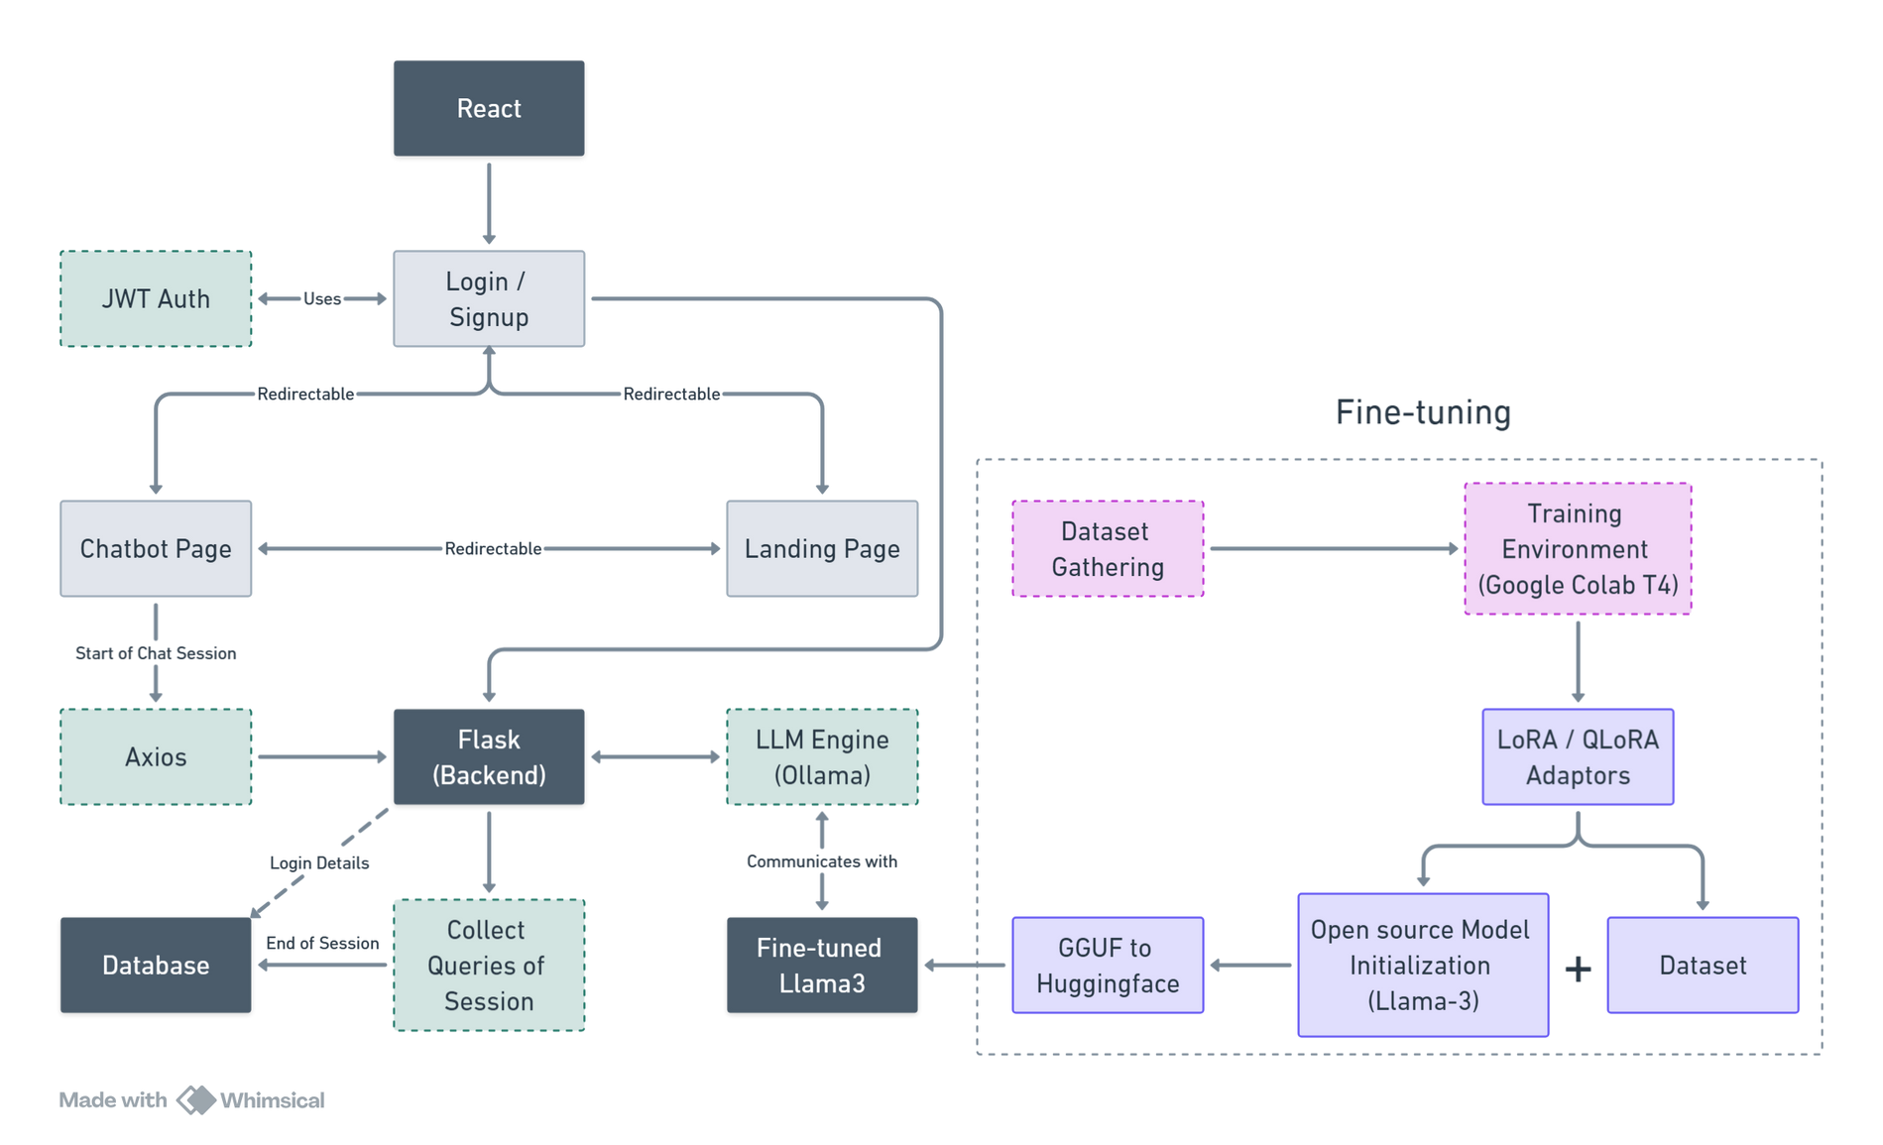
Architecture

Slide 5
DEMONSTRATION

Slide 6
THANK YOU

